Slide 1

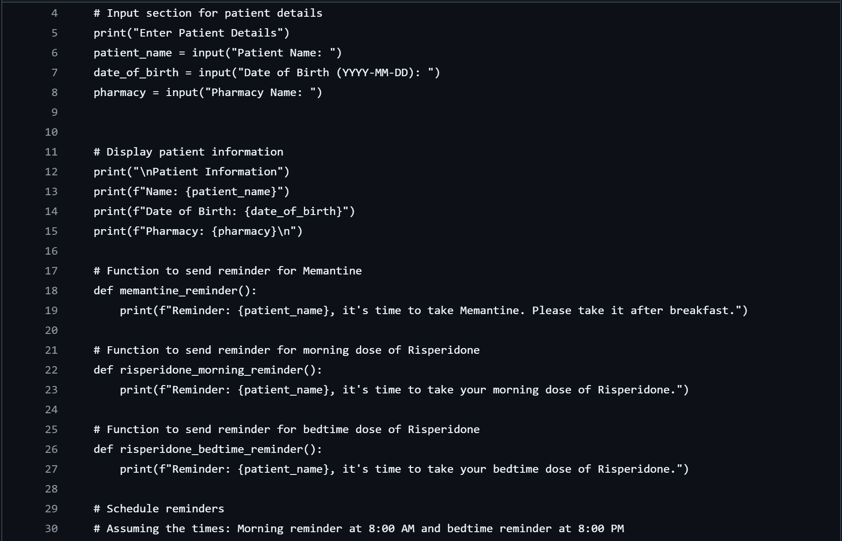
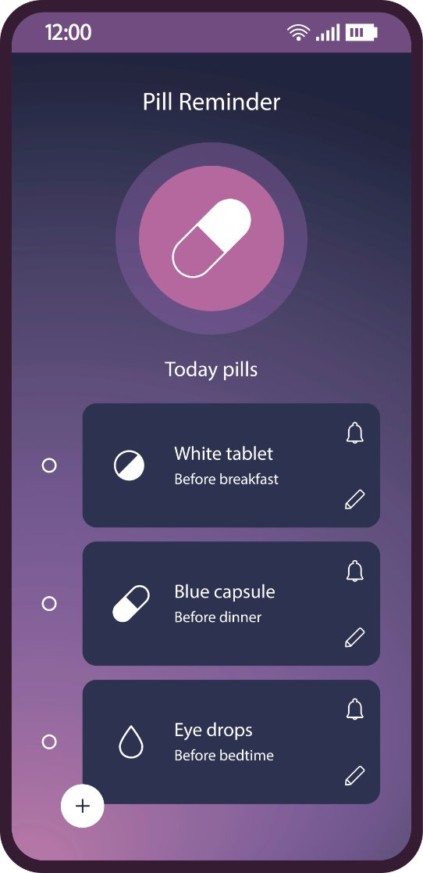
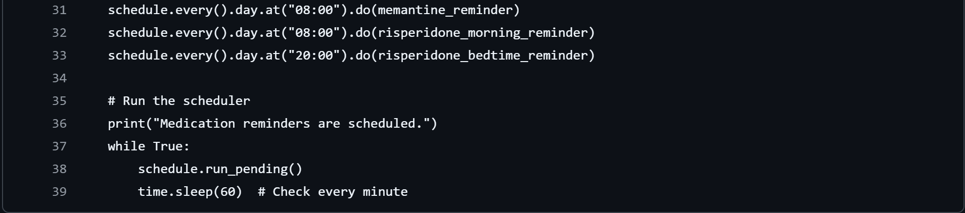
Medicine Reminders Application
Smart Medication Reminders for Safety, Independence, and Enhanced Care Coordination
This app enhances medication adherence by connecting with EHR systems and providing real-time access to intake data for patients, caregivers, and providers. It uses QR codes scanned at the pharmacy and a smart bottle with locking and weight-tracking features to ensure correct dosing and prevent overuse. Designed for elderly users and those with chronic conditions, it supports patient safety, reduces medication errors, and empowers users to manage their health independently.
Alzheimer's Medication Example
Macy Roy, Katherine Wolz, Michaelia Jonas and Kiera Hughes

